Slide 1


IT351
Group 31
Voice Assistant
Group Members:
Sanket Hanagandi – 201IT154
Mayur Jinde – 201IT135
Shaulendra Kumar - 201IT159
Kartikeya Ranjan – 201IT127

Slide 2

Abstract
Today's technical advancements are developing at a breakneck speed. Previously, we only had access to a computer system that allowed us to accomplish a restricted number of tasks. Machine learning, artificial intelligence, deep learning, and other technologies, on the other hand, have enhanced computer systems to the point where we can now complete any task. If individuals are still struggling to communicate via numerous input devices in this day and age, it's not worth it. As a result, we included a voice assistant into the system. A voice assistant's main purpose is to eliminate the use of input devices like a keyboard and mouse. It will also save on hardware space and money.

Slide 3

Methodology
The methodology can be divided into three steps namely:
Speech to Text
Text Analyzing
Interpret the Command

Slide 4
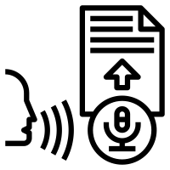
Speech to Text
A piece of code converts audio to text.
To do this the python library used is Speech Recognition. It’s a Text to speech library developed by Microsoft sapi5 engine, it’s used here because sapi5 is made for windows.
Sometimes it does not understand what you say but there’s an exception handling to deal with this issue.

Slide 5

Text Analyzing
As the speech is converted to text.
The text arguments are passed through the program to interpret the command. Then the program checks whether the passed arguments are valid or not. This is done by the test analyzing library - pyttsx3 · PyPI
If it’s valid, it executes the command, else throws an exception.

Slide 6

Interpret the Command
If the command is to access a website, then the program contacts the server to open the desired website.
The python library which is used to do this is Web Browser - Convenient web-browser controller.
It’s a Web browser API used for opening web browsers.

Slide 7

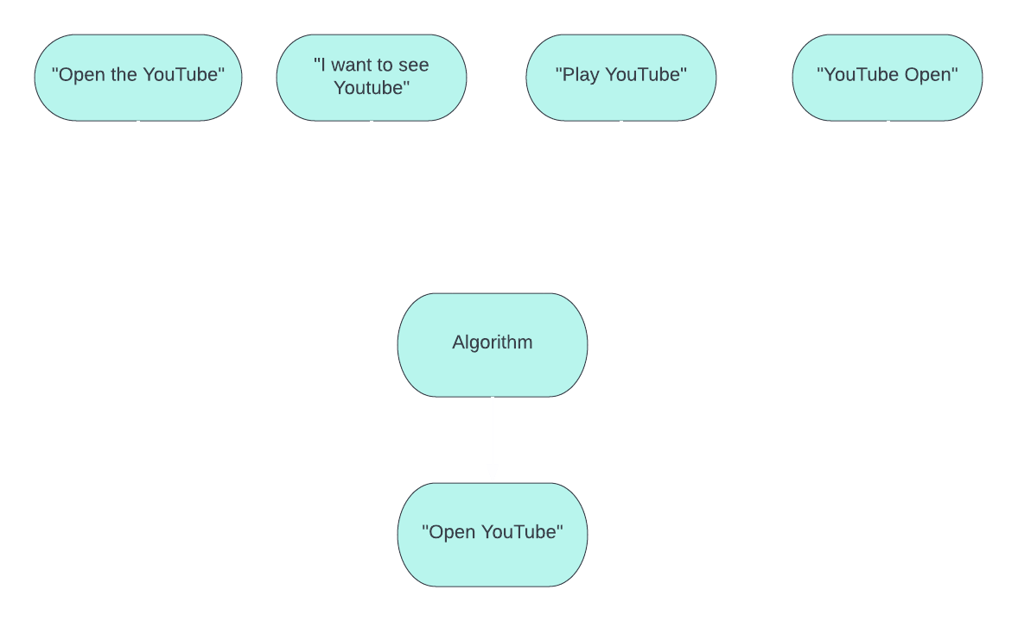
Novelty
After the user says the command in his desired way, and when the speech is converted to text, as shown in in the diagram we then convert the input text into a standard input text that is understandable by the program.
For example, here various commands from the user like "Open the YouTube“, "I want to see Youtube“, "Play YouTube“, "YouTube Open“ are converted to a standard input text here as "Open YouTube“.

Slide 8
Research Paper
Link for research paper

Slide 9

Thank You

